Slide 1
Recent Applications of Active Learning in Computer Vision
IVUL Group Meeting – ETC (45 Mins)
September 28, 2017
Fabian Caba Heilbron

Slide 2
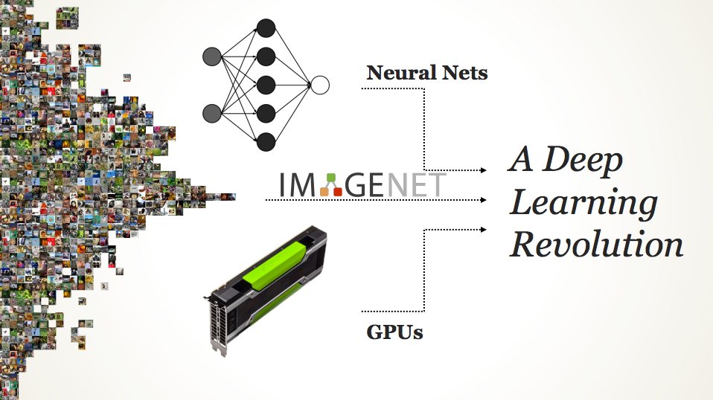

Slide 3
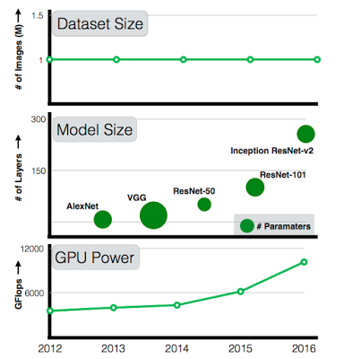
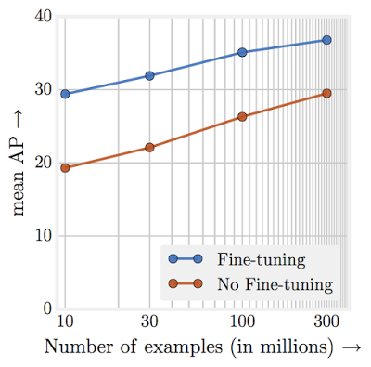
Revisiting Unreasonable Effectiveness of Data in Deep Learning Era. Chen Sun et al., 2017

Slide 4
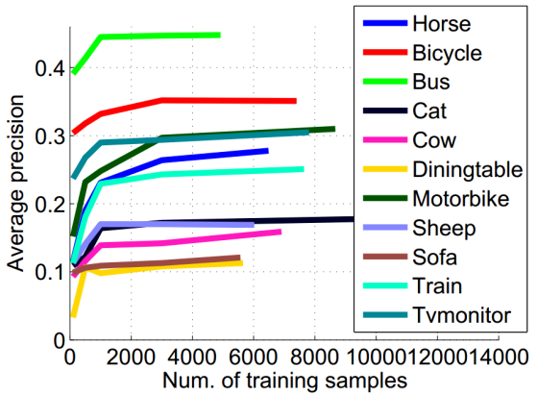
But before Deep Learning …

Slide 5

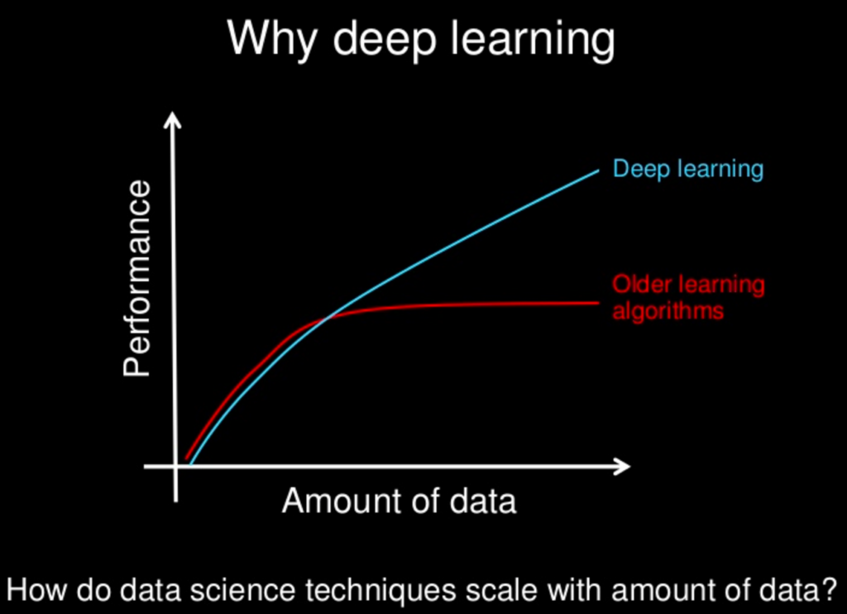
But before Deep Learning …

Slide 6
Smartly Annotating Samples
Vision Task Performance
Number of Samples

Slide 7
Smartly Annotating Samples
“Passive” learning
Vision Task Performance
Number of Samples

Slide 8
Smartly Annotating Samples
Active learning
“Passive” learning
Vision Task Performance
Number of Samples

Slide 9
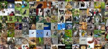


Active Learning
Unlabeled data
Vision
Model
Inference
Labeled Examples
Predictions
Selected
Examples
Active Selection
Oracle

Slide 10
Active Learning
Goal: train better models faster and cheaper.
Better data is often more useful than simply more data.
Data collection may be expensive
Collect weak annotations.
Computer-assisted annotation tools.

Slide 11
Uncertainty Sampling
Query the event that the current classifier is most uncertain about
Needs measure of uncertainty, probabilistic model for prediction
Examples:
Entropy
Least confident predicted label
Euclidean distance (e.g. point closest to margin in SVM)

Slide 12
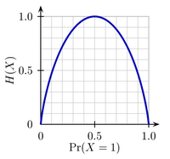
A Measure of Information
A measure of information in random event X with possible outcomes {x₁,…,x_{n}}
Comments on entropy function:
Entropy of an event is zero when the outcome is known
Entropy is maximal when all outcomes are equally likely
The average minimum number of yes/no questions to answer some question
Related to binary search
H(x) = - Σ_{i} p(x_{i}) log₂ p(x_{i})
[Shannon, 1948]

Slide 13
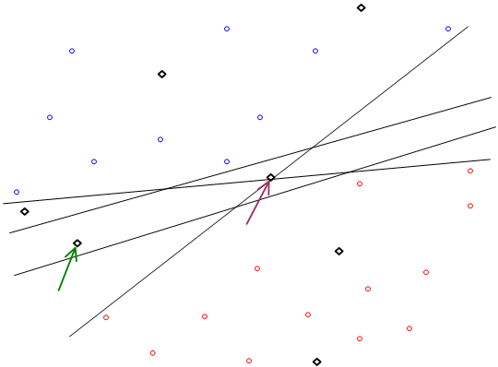
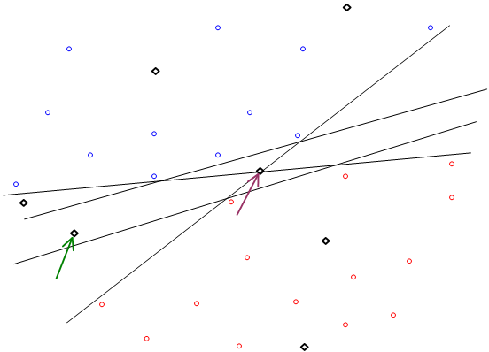
Query by Committee
Which unlabeled point should you choose?

Slide 14
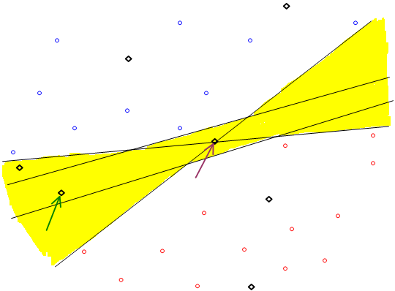

Query by Committee
Yellow = valid hypotheses

Slide 15
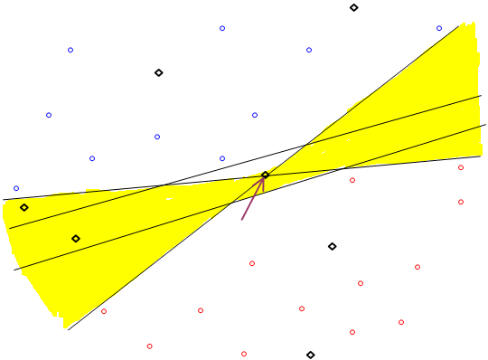

Query by Committee
Point on max-margin hyperplane does not reduce the number of valid hypotheses by much

Slide 16
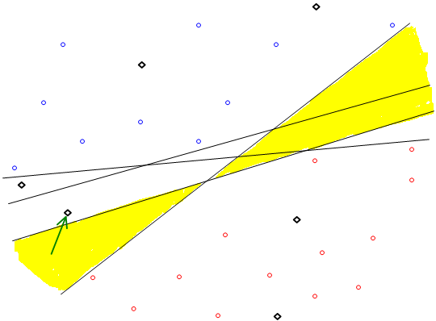

Query by Committee
Queries an example based on the degree of disagreement between committee of classifiers

Slide 17
Query by Committee
Prior distribution over classifiers/hypotheses
Sample a set of classifiers from distribution
Natural for ensemble methods which are already samples
Random forests, Bagged classifiers, etc.
Measures of disagreement
Entropy of predicted responses
KL-divergence of predictive distributions

Slide 18
References
Some of the most influential papers
Simon Tong, Daphne Koller. Support Vector Machine Active Learning with Applications to Text Classification. Journal of Machine Learning Research. Volume 2, pages 45-66. 2001.
Y. Freund, H. S. Seung, E. Shamir, N. Tishby. 1997. Selective sampling using the query by committee algorithm. Machine Learning, 28:133—168
David Cohn, Zoubin Ghahramani, and Michael Jordan. Active learning with statistical models, Journal of Artificial Intelligence Research, (4): 129-145, 1996.
David Cohn, Les Atlas and Richard Ladner. Improving generalization with active learning, Machine Learning 15(2):201-221, 1994.
D. J. C. Mackay. Information-Based Objective Functions for Active Data Selection. Neural Comput., vol. 4, no. 4, pp. 590--604, 1992.

Slide 19
NIPS papers
Francis Bach. Active learning for misspecified generalized linear models. NIPS-06
Ran Gilad-Bachrach, Amir Navot, Naftali Tishby. Query by Committee Made Real. NIPS-05
Brent Bryan, Jeff Schneider, Robert Nichol, Christopher Miller, Christopher Genovese, Larry Wasserman. Active Learning For Identifying Function Threshold Boundaries . NIPS-05
Rui Castro, Rebecca Willett, Robert Nowak. Faster Rates in Regression via Active Learning. NIPS-05
Sanjoy Dasgupta. Coarse sample complexity bounds for active learning. NIPS-05
Masashi Sugiyama. Active Learning for Misspecified Models. NIPS-05
Brigham Anderson, Andrew Moore. Fast Information Value for Graphical Models. NIPS-05
Dan Pelleg, Andrew W. Moore. Active Learning for Anomaly and Rare-Category Detection. NIPS-04
Sanjoy Dasgupta. Analysis of a greedy active learning strategy. NIPS-04
T. Jaakkola and H. Siegelmann. Active Information Retrieval. NIPS-01
M. K. Warmuth et al. Active Learning in the Drug Discovery Process. NIPS-01
Jonathan D. Nelson, Javier R. Movellan. Active Inference in Concept Learning. NIPS-00
Simon Tong, Daphne Koller. Active Learning for Parameter Estimation in Bayesian Networks. NIPS-00
Thomas Hofmann and Joachim M. Buhnmnn. Active Data Clustering. NIPS-97
K. Fukumizu. Active Learning in Multilayer Perceptrons. NIPS-95
Anders Krogh, Jesper Vedelsby. NEURAL NETWORK ENSEMBLES, CROSS VALIDATION, AND ACTIVE LEARNING. NIPS-94
Kah Kay Sung, Partha Niyogi. ACTIVE LEARNING FOR FUNCTION APPROXIMATION. NIPS-94
David Cohn, Zoubin Ghahramani, Michael I. Jordan. ACTIVE LEARNING WITH STATISTICAL MODELS. NIPS-94
Sebastian B. Thrun and Knut Moller. Active Exploration in Dynamic Environments. NIPS-91

Slide 20
ICML papers
Maria-Florina Balcan, Alina Beygelzimer, John Langford. Agnostic Active Learning. ICML-06
Steven C. H. Hoi, Rong Jin, Jianke Zhu, Michael R. Lyu. Batch Mode Active Learning and Its Application to Medical Image Classification. ICML-06
Sriharsha Veeramachaneni, Emanuele Olivetti, Paolo Avesani. Active Sampling for Detecting Irrelevant Features. ICML-06
Kai Yu, Jinbo Bi, Volker Tresp. Active Learning via Transductive Experimental Design. ICML-06
Rohit Singh, Nathan Palmer, David Gifford, Bonnie Berger, Ziv Bar-Joseph. Active Learning for Sampling in Time-Series Experiments With Application to Gene Expression Analysis. ICML-05
Prem Melville, Raymond Mooney. Diverse Ensembles for Active Learning. ICML-04
Klaus Brinker. Active Learning of Label Ranking Functions. ICML-04
Hieu Nguyen, Arnold Smeulders. Active Learning Using Pre-clustering. ICML-04
Greg Schohn and David Cohn. Less is More: Active Learning with Support Vector Machines, ICML-00
Simon Tong, Daphne Koller. Support Vector Machine Active Learning with Applications to Text Classification. ICML-00.
COLT papers
S. Dasgupta, A. Kalai, and C. Monteleoni. Analysis of perceptron-based active learning. COLT-05.
H. S. Seung, M. Opper, and H. Sompolinski. 1992. Query by committee. COLT-92, pages 287--294.

Slide 21
Journal Papers
Antoine Bordes, Seyda Ertekin, Jason Weston, Leon Bottou. Fast Kernel Classifiers with Online and Active Learning. Journal of Machine Learning Research (JMLR), vol. 6, pp. 1579-1619, 2005.
Simon Tong, Daphne Koller. Support Vector Machine Active Learning with Applications to Text Classification. Journal of Machine Learning Research. Volume 2, pages 45-66. 2001.
Y. Freund, H. S. Seung, E. Shamir, N. Tishby. 1997. Selective sampling using the query by committee algorithm. Machine Learning, 28:133--168
David Cohn, Zoubin Ghahramani, and Michael Jordan. Active learning with statistical models, Journal of Artificial Intelligence Research, (4): 129-145, 1996.
David Cohn, Les Atlas and Richard Ladner. Improving generalization with active learning, Machine Learning 15(2):201-221, 1994.
D. J. C. Mackay. Information-Based Objective Functions for Active Data Selection. Neural Comput., vol. 4, no. 4, pp. 590--604, 1992.
Haussler, D., Kearns, M., and Schapire, R. E. (1994). Bounds on the sample complexity of Bayesian learning using information theory and the VC dimension. Machine Learning, 14, 83--113
Fedorov, V. V. 1972. Theory of optimal experiment. Academic Press.
Saar-Tsechansky, M. and F. Provost. Active Sampling for Class Probability Estimation and Ranking. Machine Learning 54:2 2004, 153-178.

Slide 22
Recent Computer Vision Methods Using Active Learning (AL)

Slide 23
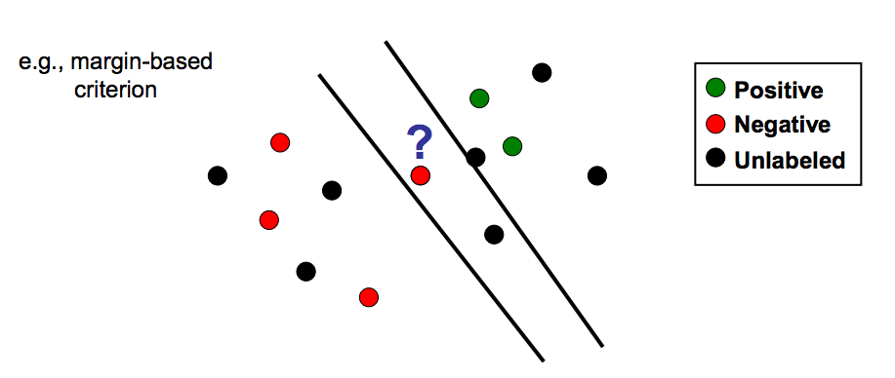
Traditional AL in Computer Vision

Slide 24
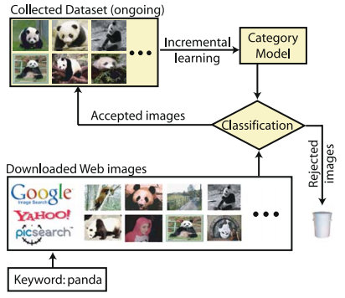
AL to Annotate ImageNet?
Jia Li et al. IJCV 2009

Slide 25
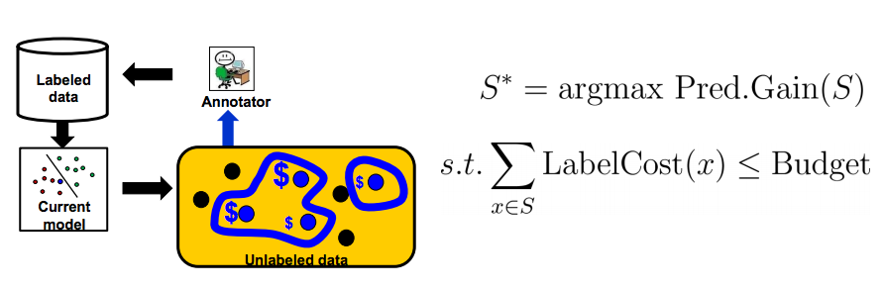
AL on a Budget
Vijayanarasimhan et al. CVPR 2010

Slide 26

2011 - 2015

Slide 27
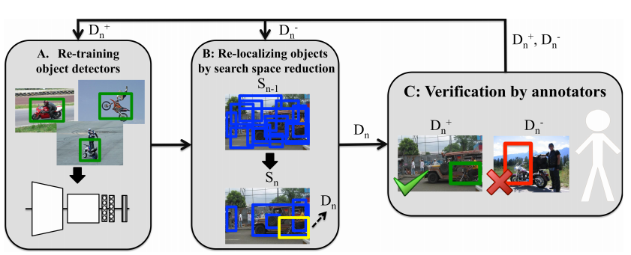
AL with weak (cheap) supervision
Papadopoulus et al. CVPR 2016

Slide 28
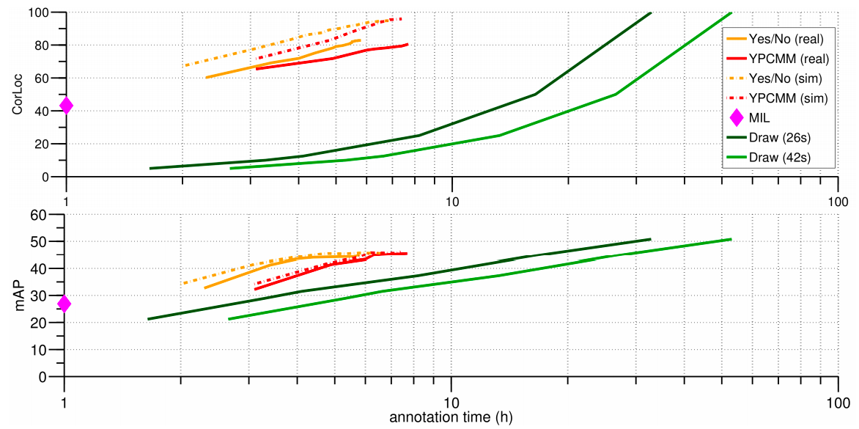
AL with weak (cheap) supervision
Papadopoulus et al. CVPR 2016

Slide 29
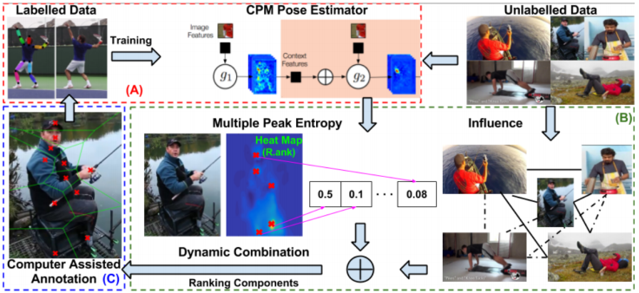
AL for Human Pose Estimation
Notes:
Similar and uncertain: Similar → propagate information; uncertain → hard examples + diversity

Slide 30
Active Learning Frontiers

Slide 31
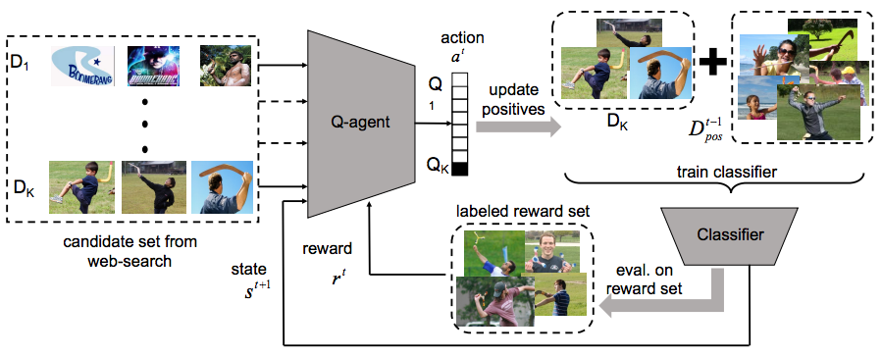
Learning to Learn from Noisy Samples
Yeung et al. CVPR 2017

Slide 32
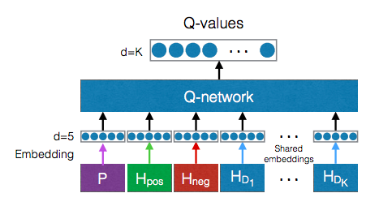
Learning to Learn from Noisy Samples
Yeung et al. CVPR 2017

Slide 33
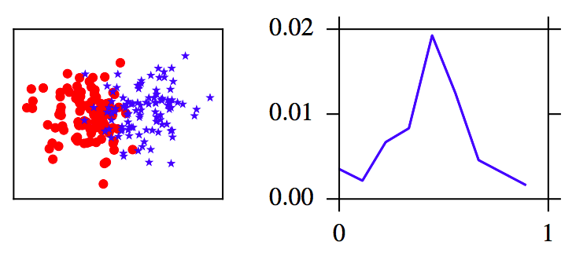
Learning Active Learning from Data
Konyushkova et al. NIPS 2017

Slide 34
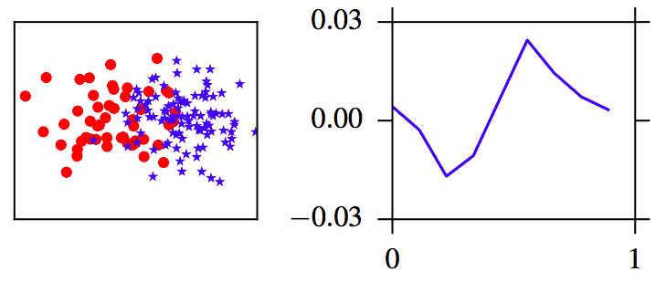
Learning Active Learning from Data
Konyushkova et al. NIPS 2017

Slide 35
Learning Active Learning from Data
Goal: Learn a model able to regress the reduction in generalization error that can be expected by adding a label to a point. This regression model should be able to generalize to novel tasks!
Konyushkova et al. NIPS 2017

Slide 36
How to learn the regression model?
Step 1: Obtain a labeled dataset.
Labeled dataset
Konyushkova et al. NIPS 2017

Slide 37
How to learn the regression model?
Step 2: Sample the original labeled set.
Labeled dataset (sampled)
Labeled dataset
Konyushkova et al. NIPS 2017

Slide 38
How to learn the regression model?
Step 3: Fit a model for your target task.
Labeled dataset (sampled)
Labeled dataset
Model
Konyushkova et al. NIPS 2017

Slide 39
How to learn the regression model?
Step 4: Run model on remaining unlabeled examples.
Labeled dataset (sampled)
Labeled dataset
Model
Unlabeled samples (fake)
Konyushkova et al. NIPS 2017

Slide 40
How to learn the regression model?
Step 5: Concat. model and predictions state.
Labeled dataset (sampled)
Model
State
Labeled dataset
Model
Observation
Pred.
State
Unlabeled samples (fake)
Konyushkova et al. NIPS 2017

Slide 41
How to learn the regression model?
Step 6: Evaluate Model on validation set.
Labeled dataset (sampled)
Evaluate on Validation set
Model
Validation
Error
Konyushkova et al. NIPS 2017

Slide 42
How to learn the regression model?
Step 7: Subtract previous val. Error.
Labeled dataset (sampled)
Evaluate on Validation set
Target
Model
Validation
Error
Previous
Validation Error
Konyushkova et al. NIPS 2017

Slide 43
How to learn the regression model?
Step 8: Construct observation matrix and target vector.
Observations
Targets
Konyushkova et al. NIPS 2017

Slide 44
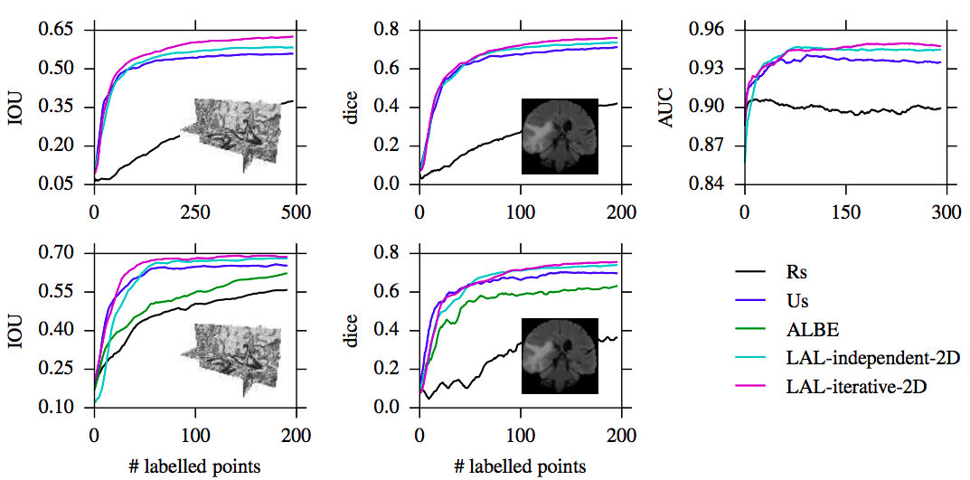
Does it work?
Konyushkova et al. NIPS 2017

